Slide 1
Leaving the SOM and Entering Your Professional Career
Class of 2019
Office of Medical Education
Career Counseling for Students and Road to Match
Notes:
General congratulations
Changes ahead
Time period between now and match week
Work of the Office of Medical Education regarding career counseling
Purpose of the Road to Match series

Slide 2
Notes:
Changes in expectation
Purpose of the meetings with the chief residents

Slide 3
Hearing from You
AAMC Medical Student Graduation Questionnaire
UMMC’s Residency Program Director’s Survey
Notes:
The age of surveys
Two final important upcoming surveys
Special year with the ISA

Slide 4
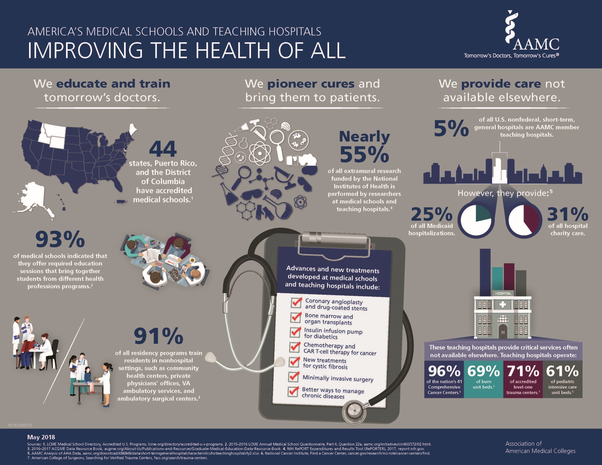
AAMC Graduation Questionnaire
Notes:
Broad scope of the AAMC

Slide 5
AAMC Graduation Questionnaire
Collaborative activity of the AAMC and its member medical schools
Seeks information from graduating medical students about all four years of medical school - used to improve medical education at both the local and national levels
Opens in February of 2016 - takes 30-45 minutes to complete
Participation is voluntary – but there are incentives from the school to complete it by Match week!
Notes:
Final AAMC survey – MCAT preparation, matriculating students, year 2 students and graduating students

Slide 6
GQ Prizes at the Match Day Ceremony
During the Match Day ceremony, a drawing has been held in the past for the following prizes:
$400 gift card from Best Buy
$200 gift card from Bravo/Broad Street/Sal and Mookies
$100 gift cards from the UMMC bookstore
Random drawings between the first week that the survey is available and Match Day
Instructions will be sent by Robyn Herring in February
Notes:
Plan for now

Slide 7
Residency Program Director’s Survey
Allows us to make improvements to our medical school curriculum
Sent in March of your intern year to your residency program director
Survey is administered in Survey Monkey
Responses are in aggregate form – unless the PD mentions you by name, we can’t tell what the PD said about you
Need a permission form from each of you, indicating whether you agree or don’t agree to participate – will pick up forms right now
Notes:
Final survey regarding each of you
Some changes to the M4 curriculum based on this information

Slide 8
Residency Program Director’s Survey
Upon arrival to your program, how prepared was this residency to perform satisfactorily compared to graduates of other medical schools?
- More prepared - As prepared
- Less prepared - Remedial work necessary
In your best professional judgment, how prepared was this resident in each of the following areas: (very prepared, prepared, unprepared, very unprepared)
- Knowl. of basic sciences - Problem solving skills
- Diagn./interven. skills - Routine technical procedures
- Oral, written commun. - Ethics
- Interpersonal relations - Professionalism
What are the primary strengths of this resident?
What are the primary weaknesses of this resident?

Slide 9
