Slide 1

THE M4 YEAR
Class of 2020

Slide 2
The M4 Year – Moving from UME to GME
Basic knowledge acquisition and assessment
Professionalism foundation and refinement
Strengthening of characteristics to provide competent and compassionate care
Continuation of basic medical education with specialty emphasis
Emphasis on quality care
Core preparation for supervised clinical care in any specialty
Preparation for unsupervised clinical care

Slide 3

The M4 Year – Moving from UME to GME
Skills

Slide 4
Overview of the
M4 Year
Preparation for clinical care as residents - M4 year course requirements geared towards this goal
Exploration of different specialties through electives
Exploration of residency programs through rotations here and at other institutions
Final participation in school and community service as a student
Submission of applications for residency programs (will discuss later this morning)
Communication is critical – check email often

Slide 5
Technical Skills
In order to graduate, must complete, and log in E*Value, the seven (7) required technical skills
  Airway management
  Insertion of Foley catheter (female)
  Insertion of Foley catheter (male)
  Insertion of Intravenous Catheter
  Insertion of Nasogastric Tube
  Suture of Simple Laceration
  Venipuncture
Technical skills must be completed before the end of the M3 year in order to promote to the M4 year

Slide 6

Changing Expectations
Student to employee mindset
Educational experience to patient management experience

Slide 7
General Information about Away Rotations
Some specialties strongly encourage away rotations (emergency medicine, dermatology, urology, plastic surgery, ENT, neurosurgery, Optho, etc.) – if you are considering one of these, go ahead and begin working on a plan.
Away rotations may be taken from July through April – take yours early if you want an LOR for residency applications (before 10/1?)
Up to two (2) away rotations may be taken for credit towards elective requirement.

Slide 8
Applying for
Away Rotations
Access has been given to you to register and submit applications through VSAS, a platform most schools use to manage away rotations.
Students can upload documents (photo, CV, immunization records) and see available offerings across the country. UMMC will upload your transcript and provide additional data.
If you’re interested a school that doesn’t use VSAS, you’ll have to investigate their requirements on the schools education website
Pay attention to dates/deadlines – application dates vary by institution. Most programs accept applications between March and May.

Slide 9

General Information about Away Rotations
Complete an online UMMC extramural form to begin the process. The form is sent electronically to the appropriate department for approval and then to Student Affairs, Registrar and the Liability Policy Provider. It must be completed in IE on a PC while on the UMC Intranet.
You have $2,000,000 per incident and $3,000,000 aggregate of liability coverage. That’s the most we can get for you.

Slide 10
Go to https://workflow.umc.edu and select "M4 Extramural Request" from the processes listed on the left hand navigation pane. You must use Internet Explorer.

Slide 11
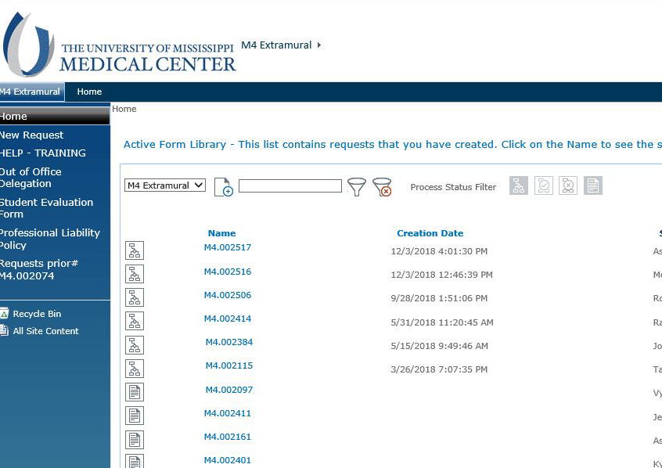
Click "New Request" to begin the UMC Extramural request process. Approval assures you are eligible for academic credit and liability coverage

Slide 12
Complete each field in the form. When you choose a department, names will populate a field below the statement "Attention Student:"

Slide 13
You will need to move these names from the "NOT on team" box to the "ON team" box. This process electronically directs the form to the correct departmental officials for approval.

Slide 14
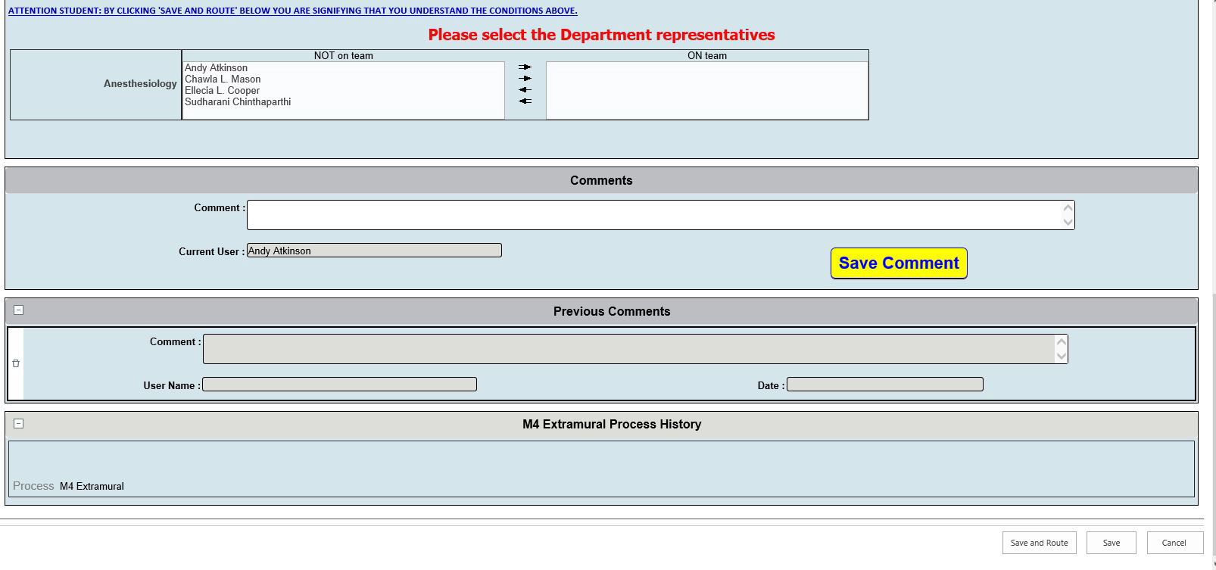
When finished, click "Save and Route"

Slide 15
General Information about Away Rotations
Make sure you’re up to date on your immunizations at Student Health (ask for documentation using the AAMC Standard Immunization Form if your school requires it, or our Student Immunization Compliance Statement, I emailed both forms to you)
Get your Flu Shot
Work on your CV (see emailed sample)
Get your picture take at BMI
Do any required online Compliance Training
Are you current on your TB Skin Test?
Get a Mask Fit documented at Student Health (you need an appointment for this)

Slide 16
USMLE Step 2 CK and CS
Must have passing scores by May graduation
The decision of when to take the tests is up to you. The dean with whom you will meet to discuss your residency match plans can give input
Program directors are interested in Step 2 scores. If you have a low Step 1 score, consider taking Step 2 early enough to have scores back when applications release to programs on Sept. 15th

Slide 17
USMLE Step 2 CK and CS
Exam fee: USMLE Step 2 CK-$630.00; Step 2 CS-$1,290.00; Eligibility Period Extension (moving your 90 day testing window)-$70.00
Step 2 CK is taken at a Prometric Testing Center. Step 2 CS is taken at NBME regional testing center (typically Atlanta and Houston)

Slide 18
USMLE Step 2 CK and CS
Step 2CS Notes: 2 students took it in very late May, 104 in June, 21 in July, 19 in August. Understand that pressure exists on the five national testing centers for Step 2 CS and score reporting is slow. Also be advised that results from our Clinical Skills Exams correlate closely with Step 2 CS results. Remember you’ll be taking what serves as a simulated Step 2 CS in May. This is an excellent resource for gauging your readiness but isn’t totally effective unless you go back and review your results with the CSA Center Staff at the appointed time. Our current pass rate for Step 2CS was 94%.

Slide 19
USMLE Step 2 CK and CS
Step 2CK Note: 45 students took it in June, 75 in July, 19 in August. Our pass rate was 95%.
All M3's should have received 360 days of access to Kaplan’s Step 2 CK question bank compliments of the SoM earlier in the year. If you have experienced difficulty respond via email and I'll have the code/instructions resent to you. We’ll also provide access to a NBME produced ½ test (like we did for Step1) in early May to be used as you see fit. I'm also glad to help in other ways...just let me know when/how?

Slide 20
The New and Improved M4 Year
Dr. Sajani Tipnis

Slide 21
Why Change?
What is the goal of the M4 year?
  RIME model
The M4 is a transition to Graduate Medical Education
  Boot Camp
Begin transitioning to more focused self directed learning
  Active Learning Portfolios
Increased procedural competency
  Student feedback
  Technical skills-elementary
  Procedural rotation-advanced
The ability to take care of complex patients
  Residency Program Directors survey

Slide 22
Core Requirements-Must be 4 weeks in length
Sub-internship
  Medicine, Family Medicine, or Peds
Critical Care
  NICU, PICU, SICU, NSICU,MICU
Procedural Rotation
  Surgery, anesthesia, interventional radiology and interventional cardiology
Ambulatory Rotation
Transition to Residency M4 Boot Camp
  Everyone back on campus for Match
  Medical/surgical/pediatric

Slide 23
Breakdown
46 week year with 34 required weeks of course work
Core requirement -20 weeks
Unscheduled time- up to 12 weeks
Electives-14 weeks of which 4 weeks must be done at UMMC

Slide 24
2 or 4 Week Rotations
2019-2020
Monday July 1- July 28th
July 29- August 25th
August 26th- September 22nd
September 23rd- October 20th
October 21st- November 17th
November 18th-December15th
December 16th - January 12th
January 13th- February 9th
February 10th- March 8th
March 9th- April 5th
April 6th- May 3rd
May 4th- May 17nd ( 2 weeks)

Slide 26
New Selective and Elecitve Opportunities
See the distributed information

Slide 27
The M4 Career and Elective Advising Site
Canvas

Slide 28
Active Learning Portfolios
ALP

Slide 29
So how does my M4 schedule get created?

Slide 30
Creating Your M4 Schedule
Schedules will be created with the E*Value Optimization Scheduling (EVOS) tool
EVOS is not a lottery tool
Every student enters their preferences for courses/months in E*Value. Preferences with the most importance are entered first in the fields at the top of the screen
The system optimizes/processes all of the requests and generates a schedule for each student

Slide 31
How to Enter Your Schedule
Log into E*Value and select the “Year 4 Program”. Click on “Schedules”, then “Preferences”, then “Scheduling Preferences”
There will be a link at the bottom of the page which lists all courses available for next year
When ready to enter your preferences, click “Next” to enter the preference screens
You will then choose courses you would like to preference and a time frame preference for each row
Most of you will begin scheduling your courses for July – if not completing your M3 year until July, you will schedule courses beginning in August

Slide 32
Things to Remember
At the end of each row, you will see a “Preference Count”, which shows how many unique options are related to your choice. This gives you an idea of how easy or difficult it might be to be scheduled in this course during your preferred month
It’s helpful to preference, in the spring, courses not in your preferred specialty – this allows students pursuing those specialties the opportunity to take those courses in the fall before/during interviews
Your chances of getting a particular course/elective will be impacted by the number of other students who are also trying to take courses in the same specialty

Slide 33
Tips for Creating Your Schedule
Number of Preferences – it is usually a good practice to provide the optimizer with enough options so that alternatives can be found
Specific vs. Vague Preferences - it is usually a good practice to be specific with the first few preferences and less specific with further down the list
Comments – you can input your preference requests or any special circumstances that may affect your schedule. These choices are not guaranteed but will be taken into consideration when creating your schedule

Slide 34
Changing Your M4 Schedule
After the schedules are created in E*Value, they will be uploaded in SAP
You may make changes once you’re notified that your schedule is uploaded in SAP
When changing your schedule in SAP, you will receive an error message (in the summer or fall terms) or a warning (in spring term) if you have:
  Over 9 rotations No MED 670, Bootcamp
  Under 8 rotations Missing core blocks
Will receive an error message in any term if you attempt to …
  Add/drop within 30 days of rotation

Slide 35
Final Reminders
An email will be sent in February to notify you when E*Value is open for optimization
Once it opens, you will have two weeks to enter your preferences. If you don’t enter choices, E*Value will assign a schedule to you with what is leftover
Once the system optimizes/processes all of the requests and generates a schedule for each student, that schedule will be available to view in SAP
With the number of students versus available course openings per month, it’s possible your schedule won’t be exactly as you hoped. Don’t panic! We will do all we can to help you end your M4 year with what you need to graduate and match

