Slide 1
THE RESIDENCY APPLICATION AND MATCH PROCESS
Class of 2020

Slide 2
The Goal Today
A quick reminder as we begin - we’re about to cover a lot of information and things you will have to do for the Match. However, don’t panic … these don’t all have to be done at one time!

Slide 3
How do I decide on a specialty?

Slide 4
Deciding on a Specialty
Talk to people who practice that specialty, both inside and outside of UMMC
Educate yourself – read/learn the positive AND negative aspects, as well as the competitiveness, of the specialty you are considering
Schedule early the rotations in which you are interested
Will receive a “Specialty Interest Form” at the end of March so we can place students with deans for Match counseling

Slide 5
What types of residency positions and programs are available?

Slide 6
Types of Residency Positions
Categorical – programs that begin in the PGY-1 year and provide the training required for board certification in medical specialties
Advanced - programs that begin in the PGY-2 year after a year of prerequisite training
Preliminary - one-year program that begins in the PGY-1 year and provides prerequisite training for advanced programs

Slide 7
Military Match
Used by all military residency programs, regardless of branch
Each branch has diff. req’s – communicate branch to Robyn in OME
Student submits appl, most documents - results publ’d in December
San Francisco Match
Used by all ophthalmology residency programs
Student submits appl, most documents - results published in January
Urology Residency Match Program
Used by most urology residency programs
Applications entered, programs applied to with the Amer.Urol.Assoc.
Student submits appl, most documents - results published in January
National Residency Match Program (NRMP)
The largest match program – used by most residency programs
Results published in March

Slide 8
Tell me more about the National Residency Match Program (the NRMP), since that’s the program most students will use

Slide 9
National Residency Matching Program (NRMP)
An algorithm matches students to the programs they rank/choose
Utilizes ERAS (Electronic Residency Application Service) for applications to programs
Will need to register for both NRMP AND ERAS with different timelines
Keep the name you use when you register, even if you get married after!
NRMP website - www.nrmp.org
Rank Order List - due 3rd week February
Match Day - usually 3rd week of March

Slide 10
So what do I need to know to get started in creating my residency application?

Slide 11
Creating Your Application
Applications are created in the various programs (ERAS, portals for SF Match, AUA, and Military)
Your application is a program’s first impression of you - use correct grammar – proof for spelling and punctuation (there is no spell/grammar check!)
Start early – completing your application takes time!
Use official school address, not a cute email address
ERAS applications – system opens in May – release to programs on September 15th
Other Match programs – check individual dates
Notes:
This year will require organization and time management.

Slide 12
Sections of the Application
Name, address, phone, email
School – name, location
Citizenship/race/ethnicity
*Felony conviction, if any
Entire education history
Awards/honors
USMLE scores
Research/publications
Volunteer work
Work experience
Language proficiency
Previous residency training
ACLS certification
Honor Societies (AOA/GHHS) - might not know these when you start your application – can go back and check the box once results are announced

Slide 13
Are there other documents I need for the Match?

Slide 14
Documents Needed
*Curriculum Vitae (CV)
Personal Statement
Photograph
USMLE Step Scores
Letters of Recommendation (LORs)
______________________________________________________________________________________________________
Medical Student Performance Evaluation (MSPE/Dean’s Letter)
Transcript

Slide 15
Curriculum Vitae (CV)
A listing of your personal information as well as undergraduate and medical school education, experience, and activities/interests – w/no gaps
Provides information for your dean’s letter writer, for faculty writing your LORs, and for those who interview you
Two versions you will create:
An electronic version - created from information you enter in your particular Match program
A hard copy – nice paper, 12 font, may be more than one page, given to LOR writers, interviewers
Examples on OME website ‘Career Advising Resources’ under CV example

Slide 16
Personal Statement
Explains your interest in a specialty, why you are a desirable applicant, how your personality and experience fit that specialty
Provides an opportunity to explain any issues not previously addressed – gaps, Step scores
Length - 1 page is best - must contain some really great information to go over one page
Don’t try to be too cute or clever - shoot for normal
Presentation on OME website ‘Road to Match Series’

Slide 17
Photograph
Professional dress
Men – suit/tie, white/blue shirt, haircut,
neatly shaved
Women - suit/solid color blouse, makeup,
minimal jewelry
Make an appointment with Biomedical Illustrations – they will send your photo to you in the correct format for ERAS
May use the photograph taken for VSAS
***Look the same for the interview

Slide 18
USMLE Step Scores
Option in ERAS and other application systems to pay to have Step scores sent from the NBME to all programs to which you apply
All scores available at the time of application are sent (Step 1 plus Step 2 CK/CS, if available)
If you receive new scores after submitting your application, you must go back into ERAS or other system to have scores retransmitted
Programs are increasingly interested in Step scores. Some even use these to filter applications. Consider taking Step 2 early enough to have scores back when applications release to programs

Slide 19
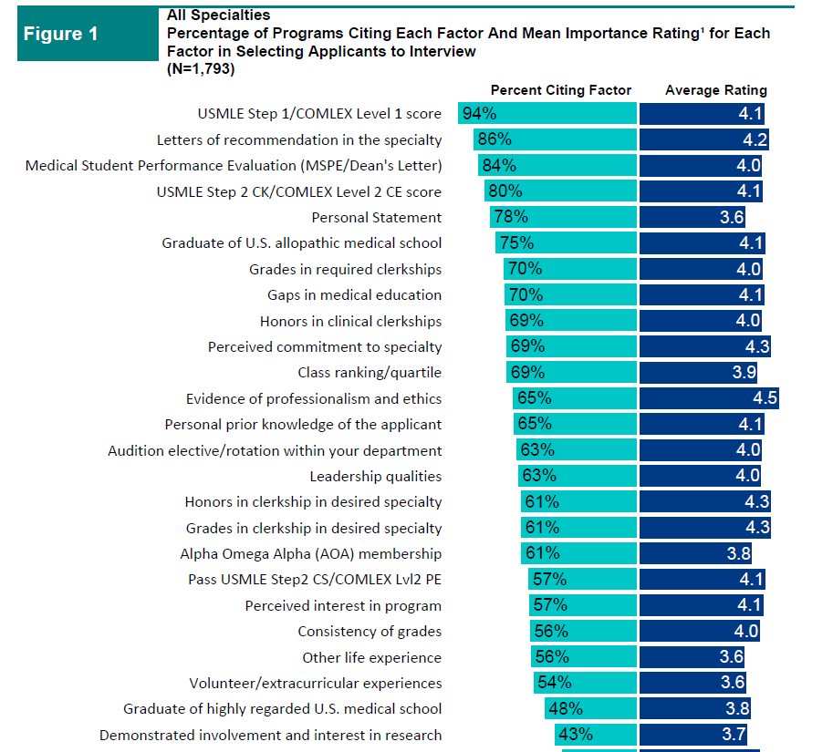

Slide 20
Letters of Recommendation (LOR)
Submit as many as you like – may designate up to four per program in ERAS
Some specialties require a letter from the department chair - include one from any away rotations
Should be from someone who knows you and has evaluated you clinically (not friends, family)
Waiving your right to see the LOR – yes or no?
LOR’s must be uploaded by the letter writer into ERAS
Notes:
Robyn will now come and talk about this in greater detail.

Slide 21
Medical Student Performance Evaluation (MSPE or Dean’s Letter)
Will be written by one of the SOM deans
Not a letter of recommendation
Comprehensive assessment of your performance in the medical school curriculum compared to your peers
Includes noteworthy characteristics, academic history and progress, and narrative information from the preclinical AND clinical years
Released in ERAS on October 1st

Slide 22
Transcript
Every application program requires a transcript to be uploaded
Our office will upload transcripts for students who register in ERAS

Slide 23
Ok, I’m overwhelmed – where can you get help as I go through this process?

Slide 24
Office of Medical Education
Our office is in charge of coordinating the match process for students
We’re here to help with questions, concerns, how-to’s, or anything else related to the Match - feel free to stop by, call, or email
Lots of information will be sent to you from our office, so check your UMMC email account often

Slide 25
Residency Application Advising Meeting
You will begin having one-on-one meetings in June with your assigned SOM dean
Your dean will offer individual guidance regarding the Match and will write your Medical Student Performance Evaluation (MSPE or dean’s letter)
Some students will need to meet earlier than June
Early matches - Ophth., Urology, Military
Competitive matches - Otolaryngology, Orthopedic Surgery, and Dermatology
You MUST have a draft of your CV in hand for the meeting - it is advisable to also have a draft of your personal statement

Slide 26
What You Will Discuss
Specialty choice and desired interview locations
Choices for away rotations, if any
Contents of your MSPE, including noteworthy characteristics, narrative comments, graphs of grades, and transcript
Challenges
Any missing information in your file
Your competitiveness and best strategy
Your “parallel” plan if needed

Slide 27
“The Road to Match” Seminars
Six seminars starting in May of 2019
Overview of the Match
ERAS Application Process
Curriculum Vitae
Interviewing
Letters of Recommendation/Personal Statement
Program Directors’ Perspective

Slide 28
What things about me are program directors trying to discover from my application?

Slide 29
Program Directors Look To See If You …
Work ethic, strengths, weaknesses (grades, LORs, MSPE)
Play well with others (clerkship comments)
Able to pass boards (if you have a borderline Step 1 score, take Step 2 early)
Have attributes to care for patients (LORs, clerkship comments)
Take criticism well (LORs, clerkship comments)
Notes:
Consider this a job application

Slide 30
Red Flags to Program Directors
Unexplained time gaps
Negative LOR
Professionalism
concerns
Course failure
USMLE failure
Unexplained leave
A “memorable”
personal stmt.
Unprofessional
photograph
Unprofessional
email address

Slide 31
Your Impact on the school’s reputation
Program Directors never forget …
The student who lied to them (“You are my number one choice”)
The student who failed to show up for an interview
Which school sent them great residents or problem residents in the past

Slide 32
What do I need to know about interviews?

Slide 33
Scheduling Interviews
The number of interviews you go on depends on several factors. Listen to the advice of your dean! ***AAMC website
Answer interview requests immediately to get desired interview date – slots fill up quickly
Think about scheduling interviews geographically so you can do a road trip
Interviews require money, so plan ahead – travel loans are available

Slide 34
The Interview Day
Be prepared
Know about the program (look at the website)
Have prepared questions and answers
Be punctual and stay for the entire time
Be interested – don’t play with your phone
Smile, act relaxed – be your best self
Be polite to everyone – you never know who votes!
Dress and act professionally
Male – suit, tasteful/conservative tie
Female – suit, minimal jewelry, small portfolio/purse
Don’t smoke or chew gum
Cancel as early as possible if you decide not to go

Slide 35
If You Don’t Get An Interview
Can consider making a call or asking someone else to call the program
Offer an intelligent reason why you should be considered
Politely ask them to reconsider and allow you to interview

Slide 36
Second Look Visits
Generally not a great idea unless strongly encouraged by a program in which you have a strong interest
Overwhelms the program and you
As an alternative, do a spring away rotation at that site

Slide 37
How will I select the programs to which I’d like to match?

Slide 38
Rank Order List (ROL)
The process of students ranking the programs at which you would like to match and programs ranking the students they would like to have match at their program
NRMP ranking opens January 2020 and closes the third Wednesday in February 2020
Class meeting in January 2020 to discuss ROL in detail

Slide 39
How much does the residency application process cost?

Slide 40
Cost of Residency Application Process
Cost varies by student and specialty but will probably include:
Fees for applying to programs – starts @ $99
Match registration fees - $65-100, depending on program (NRMP, SF, AUA)
Fees for ranking programs
Costs for interviews – transportation, lodging, meals (nat’l average is $350 per interview)
Costs for professional attire – suit, shoes

Slide 41
How will I ever remember and accomplish all of these tasks and deadlines?

Slide 42
Residency Application and Match Process
A discussion with your dean will be illuminating!

Slide 43
Match Resources
Program Directors, Attendings, Residents at UMMC
Getting into a Residency – Kenneth Iserson
First Aid for the Match
NRMP - www.nrmp.org, ERAS - www.aamc.org/eras
Ophthalmology Match - www.sfmatch.org
Urology Match – American Urological Association www.auanet.org/education/auauniversity/residents/residencyFellowship and Residency
Electronic Interactive Database Access System (FREIDA) - www.ama-assn.org
AAMC Choices newsletter - www.aamc.org/students/medstudents/cim/ choicesnewsletter/
Specialty aptitude test - www.med-ed.virginia.edu

