Slide 1
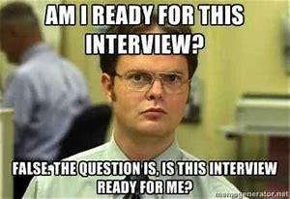
Residency Interviewing
Brad Ingram MD

Slide 2
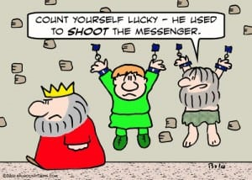
Objectives
Understand the importance of residency interviewing
Prepare effectively for a residency interview
Understand the “ropes” of a well done interview

Slide 3
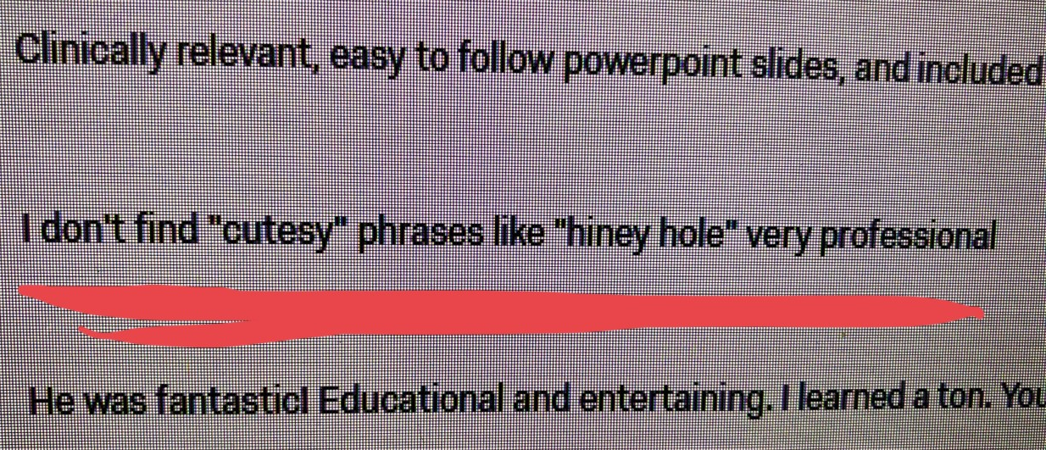
Disclosure

Slide 4


Slide 5
So does the interview matter???
Interviews are the time where we assess the “who” of you are
Paperwork assesses the “what” of you for us
You’re being screened for “do I want to work Thanksgiving with this person for the next 3 years” or “do I want this person calling and waking me up at 2am for the next 156 Saturday nights.”

Slide 6
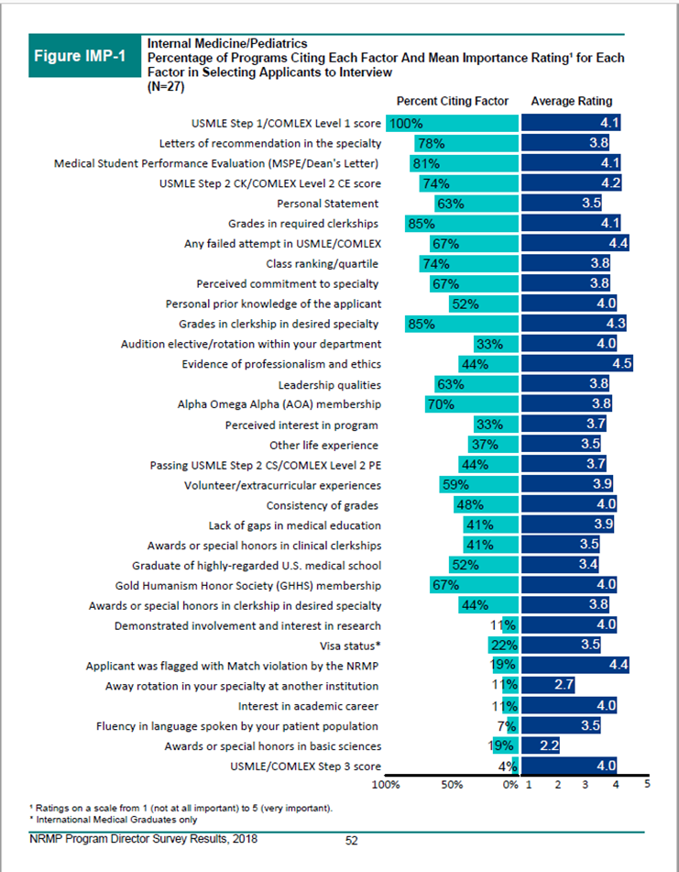

Slide 7
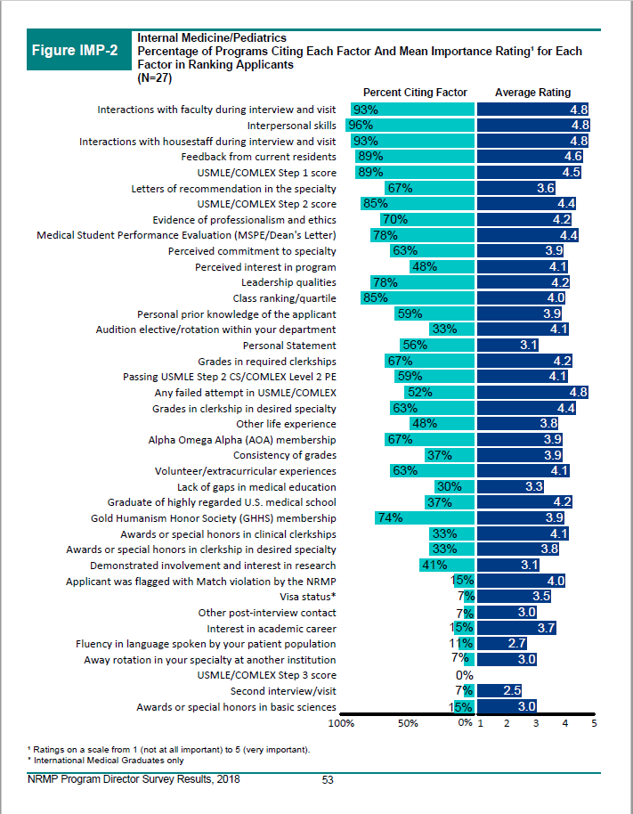

Slide 8
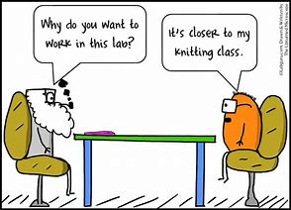
PREPARE!!!
Know the program. You picked them first, remember?
  Review the website of the program.
  If you get a list of interviewers, read about them as well
    People love to talk about themselves most, remember?
  Be prepared to ask location specific questions (even if the data was mined in the interview right before)
  And be prepared to answer why you were interested in them in the first place
    Avoid geography “Oh I just want to live in California”

Slide 9
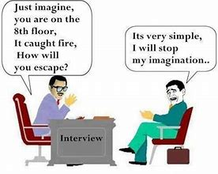
Prepare!!!
Know thyself. They picked you too, remember?
  Know an answer to your strengths and weaknesses
  Know an answer to why you’re doing what you’re doing
  Have a concept of who you want to be when you grow up (but don’t be obnoxious)
  Have a set of stories prepared for times that you were challenged, stressed, overcame adversity, experienced true joy, had a 180 degree turn in your life, were sad, were happy
    Many programs are moving to interviewing more like your medical school interview
  Have a “model” attending in mind. Have a “poor example of a physician in mind”
  REVIEW YOUR DANG CV and PERSONAL STATEMENT. You should be able to speak to that mess like it all happened yesterday
    Same thing goes for your attendings that wrote your letters.

Slide 10

Prepare!!!
Part of knowing yourself is knowing what you need out of the next 3-7 years
Don’t get seduced by this process. It’s fun and all sorts of sexy.
  But start making your wish list around your life

Slide 11
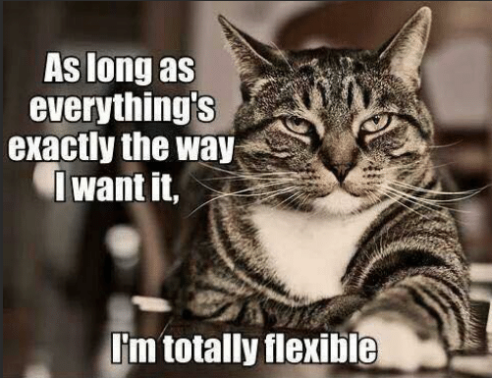
F is for the F in?????

Slide 12
What do I have with me?
  Keep an extra CV, personal statement in the room with you
    You’d be surprised hope much it helps to reference how awesome you are
  A printed agenda for the day
  Quick snacks/water that you can pop quickly between interviews
    Do NOT eat in front of people, but you will have breaks.

Slide 13
What do I have with me?
  Come up with 10 generic questions, and keep them where you can see them
    NEVER be the student who does not have questions
    Best strength, biggest weakness type stuff
      Curriculum, didactics, rotations. Anything goes
    “the residents were talking last night about…” or “I noted on your website”
    If you panic, ask about something in their office

Slide 14

This part’s tough…

Slide 15
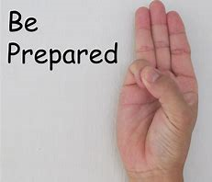
What do I do this weekend???
Shopping….
  You need (ideally) two whole sets of clothing
    Sometimes you’re on the road and a clothing snafu will FREAK YOU OUT.
    Dark colors (blue or grey suits), solids
      Avoid the “crisp white shirt” and stay away from bright red
      No small patters or checkerboard. Avoid distracting stripes.
    You need to be comfortable
    Keep jewelry conservative (both in “dangly factor, and in noise factor”)
If you wear a dark shirt, dark suit, and dark tie, you will look like you are auditioning to be a hit man on the Sopranos.

Slide 16
What do I do this weekend???
Go ahead and start your “interview wardrobe”, including trying this stuff on
  When trying it on--Sit down and see how you look seated.
  How will you iron/steam/press your items
Figure out your interview location and how you will be getting there in your fancy clothes
Get a portfolio.
  A nice black leather one
  Keep an extra CV, copy of your personal statement in it
    Both to hand out if needed, but also to review if needed

Slide 17
What do I do this weekend???
Mr. Reeve
Ladies
  Two suits. Skirts are fine, pants are more typical.
    But if you wear a skirt, it needs to be knee length, don’t make your skirt length your defining factor
  COMFORTABLE SHOES
    If you take your shoes off during an interview day, we’re gonna think that you’re a sociopath
  Clothing repair kit

Slide 18
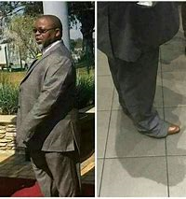
What do I do this weekend???
  Men:
    Suit. Newly or retailored. Nothing says sloppy like poorly fitting suit
    Two shirts. Get them dry cleaned when they start to look messy
    Two ties (cause of the alfredo sauce on the pasta). Maybe skip the bowties for this.
    Dress shoes. Shoe shine kit. People look
    Small sewing/button repair kit

Slide 19
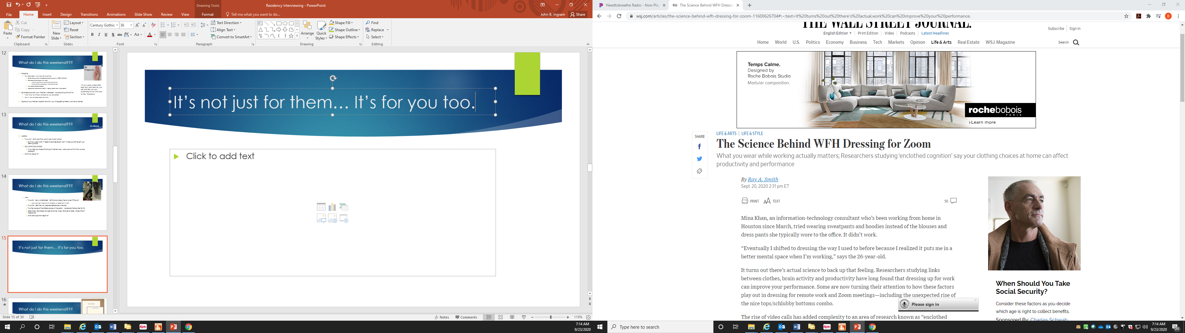
It’s not just for them… It’s for you too.

Slide 20
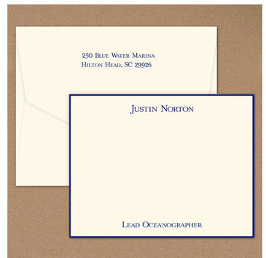
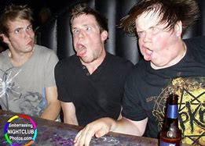
What do I do this weekend???
Buy some stationary
  Thank you notes are nice. Thank you notes with your name on them are better
  Go ahead and buy stamps
Check your social media profiles for “shenanigans NOS”
  60% of programs now report scanning social media profiles prior to
    building their rank list

Slide 21
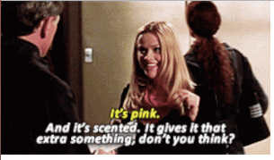
Personal Affects
You are so special. And they’re gonna love you for you.
Don’t make them remember your clothing or neck tattoo or surroundings on video
  This isn’t the time for hot pink suits or ties with Disney characters on them
Be unique for your personality. There’s plenty of time for personal expression once they’re paying you a salary
TURN OFF your cell phone. It is so disrespectful, and there really is no “safe time” to check it that day, except in the bathroom
  If your texts and things come to your computer, turn that off too.

Slide 22
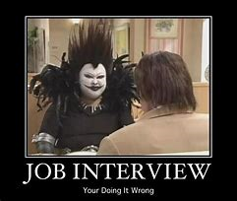
General rules
Go ahead and schedule haircuts for Oct and Nov/Dec (or more if needed)
Clean your fingernails
Limited jewelry
No exposed tattoos

Slide 23
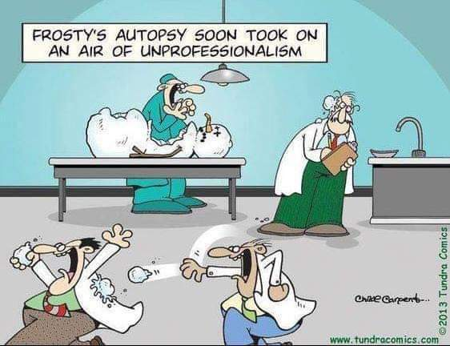
When does the interview start?
It’s already started with your emails.
  WE ALL TALK TO EACH OTHER…… Don’t be fluffy.
Residency events before the interviews are SO important
  They might not ensure your match there, but they can certainly block it
  Be pleasant, be outgoing, under no circumstances are you allowed to get hammered.
  You don’t have to ask questions about the program, or even get a lot of information that night, it’s just about being pleasant and present
  See if they’re “your people”
    Fit is the #1 thing that will ensure a successful residency experience
Be on the lookout for “miserable people”

Slide 24
Who is what???
Program director—a physician in your field and the leader of the residency program
  Many programs will also have an associate or assistant PD
Program administrator—part den mother, part camp counselor, part administrative assistant. You need this person to like you.
    Their opinion counts for A LOT
    They will be your guide through residency there if you match
    Be nice!

Slide 25
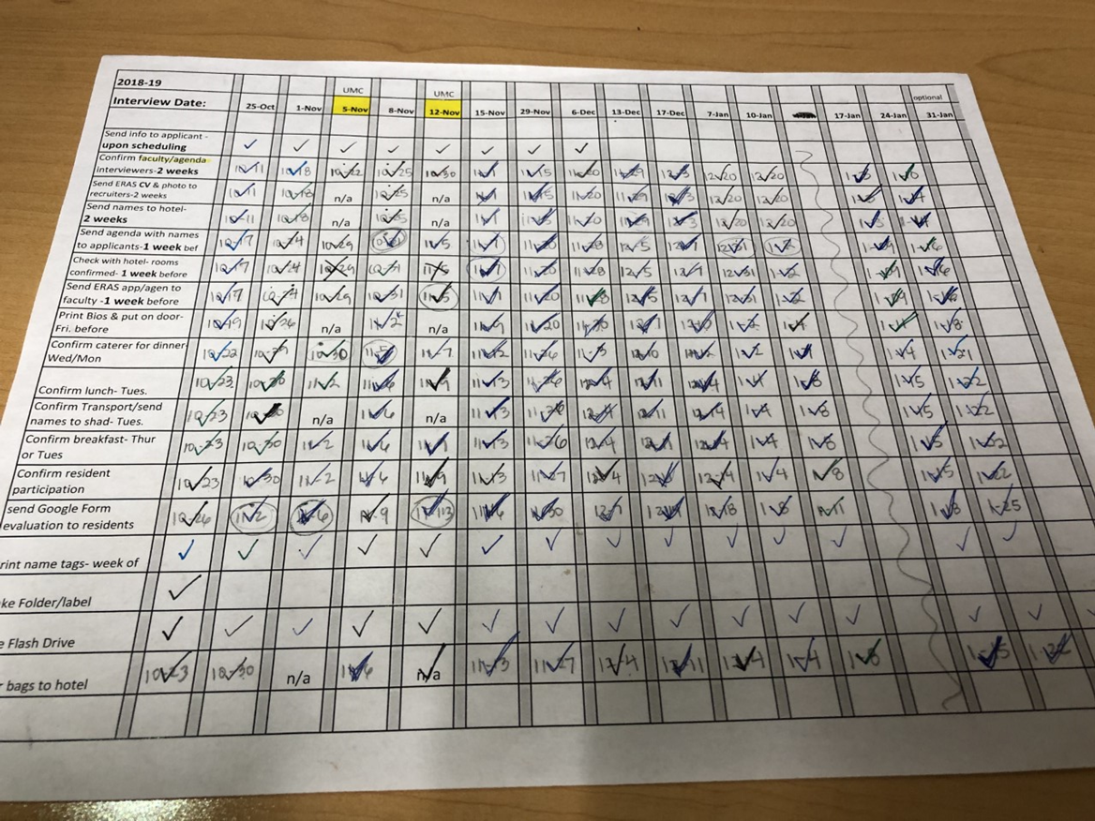

Slide 26
Interview days
Typical start with breakfast at the hotel or at a sign ins situation
Take some breakfast bars with you just in case
  Don’t do this hungry
Lunch will be provided
Most days are several interviews with key faculty and then a tour

Slide 27
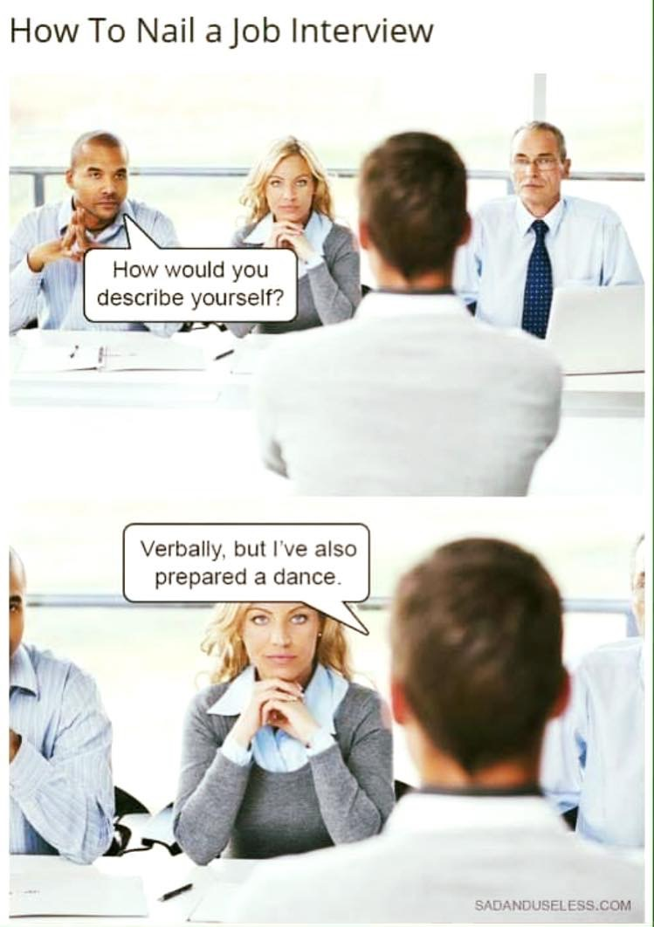
How do I interview?
Always introduce yourself,
Immediately thank them for their time today
  On ounce of courtesy is worth a pound of “being impressive”
Practice (and ask for feedback) your nonverbal behaviors
  Eye contact. Make it, but don’t drill a hole in the back of their head with it
  Keep a resting smile during the interview
  Actively listen. Nod, raise your eyebrows in pleased surprise.
  Keep your hands in your lap and away from your face (sit on them if needed)
  Don’t fidget

Slide 28
General rules
5 minutes early is on time
  There WILL be electronics snafus. Don’t be the rate limiting step.
  Remember—the interview is in THEIR time zone.
Understand your itinerary very well.
Have the phone number for the program admin handy. If something goes wrong then just call. They understand.
  IF YOU GHOST THEM THEY WILL REMEMBER YOU FOREVER

Slide 29
After the interview
Send thank you notes.
  Within 2 weeks
  Go ahead and write them that day if possible
    Keep the itinerary and write little notes next to each person so that you can remember
  Emails are fine, but if you LOVE a program do this:
    Hand written letters to program director and interviewers
    Hand written letter of thanks to program administrator
  Notes should be pleasant, and specific to what you talked about with them, or something that they pointed out to you about the program.
  If you interview early, but love them, consider a late season email telling them again how much you enjoyed your time with them.

Slide 30
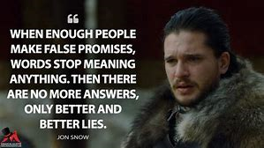
Make no promises!!

Slide 31

New ideas to prepare for:
Panel interviews
Mini interviews with standard questions
Questions about the pandemic
  “what have you learned”
  “how has your education been affected”
“Early Interest applications”

Slide 32

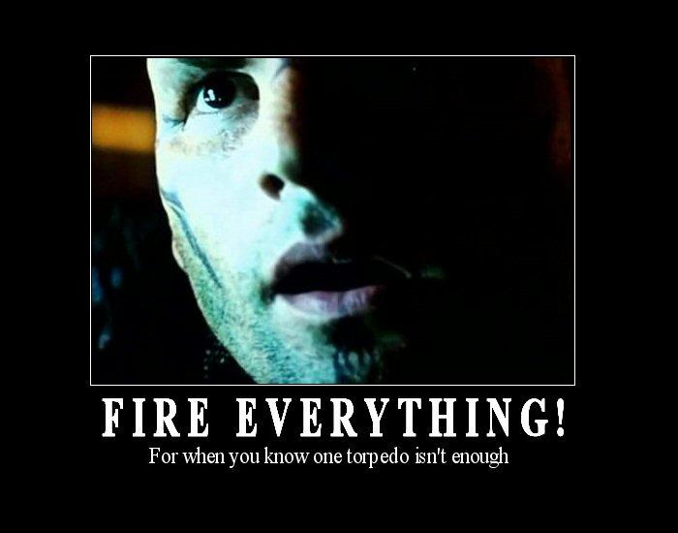
Technical skills (i.e. Set yourself up for success)
You need to know where you are interviewing and you need to practice several platforms at that location
  Wifi, wifi, wifi
  Record yourself and see how it plays back (practice with your mama or meemaw). She DEFINITELY wants to be a part of this process
Not everything is going to be zoom
Download EVERYTHING. Google Chrome, Explorer, Firefox
  Pay attention to what they email you to use
  Be conscious of time zones…. 800 our time might be 900 their time and now you’re late
Go ahead and know what your zoom/webex/big blue button et al profiles look like
  And associated emails…
Fake backgrounds are distracting, real ones are better but need to be “unmemorable”

Slide 33
Technical skills
Turn computer off and on before you get started if on campus
  It saves your last wifi, instead of the CLOSEST wifi
  ALWAYS have your computer plugged in
Airpods might not work for every platform. Don’t chose a spot where you’re not dependent on them
  Be conscious of echo (a carpeted room is better)
  Get comfortable with the mute function
Lighting is paramount. You want it in front of you, not behind you
  Light behind you puts you in silhouette
  Makes camera grainy

Slide 34
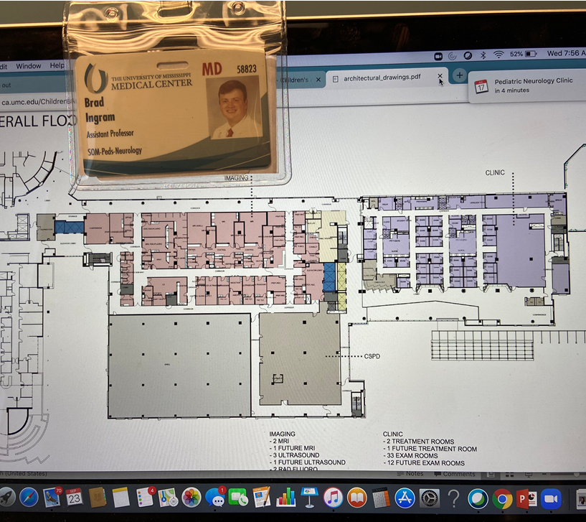
Technical skills
Camera needs to by eye level
Look at the camera
  Reposition the speaker view if possible
  If not, tape a picture next to the camera
Don’t sit in a swivel chair

Slide 35
Timeline
We get your access to your applications Sept 28.
    We’re eager and anxious. Be prepared to move fast in late Sept and Oct.
    Some interview invites will go out literally that day.
    PLEASE confirm that your ERAS email is correct. That’s how we’ll know you ☺
Be aware of the “holiday weeks”
Try to do your UMMC interview first or early

Slide 36
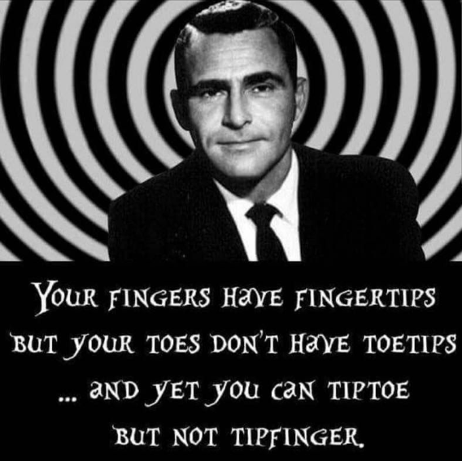
Questions!?!?!!?

