Slide 1

Road to Match
Personal Statement
&
LORs
Lyssa Weatherly, MD
Associate Program Director, Internal Medicine Residency
Assistant Dean for student Affairs

Slide 2

CV Brief overview
Dakota has covered content
You will not need this as part of your actual ERAS application
Serves as a template to import to ERAS
Given to your letter writers - Chairs, Dean/MSPE, Attendings
Have copies on hand for in-person interviews (if they happen)

Slide 3
Personal Statement
“It won’t get you into a residency but it can keep you out”
Chance to tell your story
Not a right way to do it
Limit it to ONE PAGE

Slide 4
Personal Statement
Tells WHO you are and WHY you want to do that subspecialty
Different styles
Main things to convey:
  Why did you choose this specialty?
  What are you looking for in a residency program?
  What are your future goals in that specialty?
  Why would you be a good asset to their program?

Slide 5
Styles
Patient story
Tie your interests and experiences into your choice
Your skills, qualities, strengths that make you a good fit for that specialty
Experiences (clinical, research, volunteer, etc) that helped you develop skills that are important to that specialty

Slide 6
Things to consider
Not too much “story”
When the reader finishes they should know WHY you have chosen this career
Steer away from strongly controversial opinions (politics, religion, etc)
  Your cultural or faith background can be incorporated
If you mention someone or something in your PS, it comes to the table for discussion

Slide 7
Using your PS to explain special circumstances
Explain LOAs
Discuss academic difficulties
Describe unusual circumstances faced in medical school or in personal life
Provide context and discuss lessons learned
Ask your advising dean if you question whether or not or how you should disclose or discuss something

Slide 8
Points to consider
Use a theme or find a way to make your paragraphs flow and tie thoughts together
Be careful to use correct grammar, verb tense, and spelling
Have MULTIPLE people proof it and give you feedback
  Parent, significant other, MSPE dean, physicians or residents in your specialty, English teacher

Slide 9
Don’t…
Have errors
Go over a page
Rehash why you went to medical school
Focus on fellowships
Plagiarize

Slide 10
Processing points
ERAS limits you to 28K characters
You can send different PSs to different programs
If you paste it from another program (notepad, Word, etc) check transferring format and characters
Use the view/print option to see what it will look like to the reviewer

Slide 11

Letters of Recommendation

Slide 12
LOR considerations
ERAS can store unlimited numbers
Max of 4 to each program and minimum of 3
Choose which letters you assign to which program
Have a backup in case someone is late
The MSPE is NOT a LOR

Slide 13
Letters of recommendation – WHO?
Ideally a clinical faculty in your specialty that knows you well and can clinically attest to your skills in the specialty you have chosen.
M3 attendings are fine but need at least one M4 writer
Some specialties require a Chair Letter that counts as one of your LORs
Some specialties will allow one letter from a specialty other than the one to which you’re applying
Not residents and usually not chief residents
Away rotation chair or program director is usually a necessity
LORs from non-clinical writers are typically not as favorable (unless MD/PhD)

Slide 14
Letters of recommendation – when?
Now is ok if you have a great connection
Give at least 4 weeks notice prior to due date
Tell them it’s due a week prior to the deadline (processing time)
  Deadline is Sept 28th so tell them Sept 21st
  Ask no later than end of August

Slide 15

Asking for a LOR
Remind them when they worked with you
Ask in person if able
If sending an email request, offer to meet in person
Include your PS and CV
Give them the cover letter from ERAS and the deadline

Slide 16
Example
Dr. Weatherly,
  I really enjoyed our time together on Orange Medicine in September. I feel like you were able to get to know me as a student and hope you could speak positively about my performance. I was emailing to ask if you would be able to write a strong letter of recommendation for me to apply to Pediatrics? I know you’re incredibly busy, but if you’d like to meet in person to discuss further, I’d love to meet with you. If not, I completely understand. If you are able to write it, I’ll send over my personal statement, CV, and ERAS request letter. Thank you so much for considering.
  John Smith

Slide 17
TO waive or not to waive?
Most reviewers think waived letters are more reliable, valid, and straightforward.
Most applicants comply with waiving.
I recommend you waive the right to view

Slide 18
near deadline and not turned in?
Around Sept 20th, reach out again
Thank them
Gently remind them when it’s due
Attach your ERAS request letter again
Ask if there is anything else they need from you
Dr. Weatherly,
  I just wanted to reach out and thank you again for agreeing to write a letter of recommendation for me. I was told by my dean to request it be submitted by September 21st if possible to allow for the processing time for applications to open on September 28th. I’m reattaching my ERAS request form. Please let me know if there is anything else you need from me. I know how busy you are, so thank you again for taking the time to do this for me.
    John Doe

Slide 19
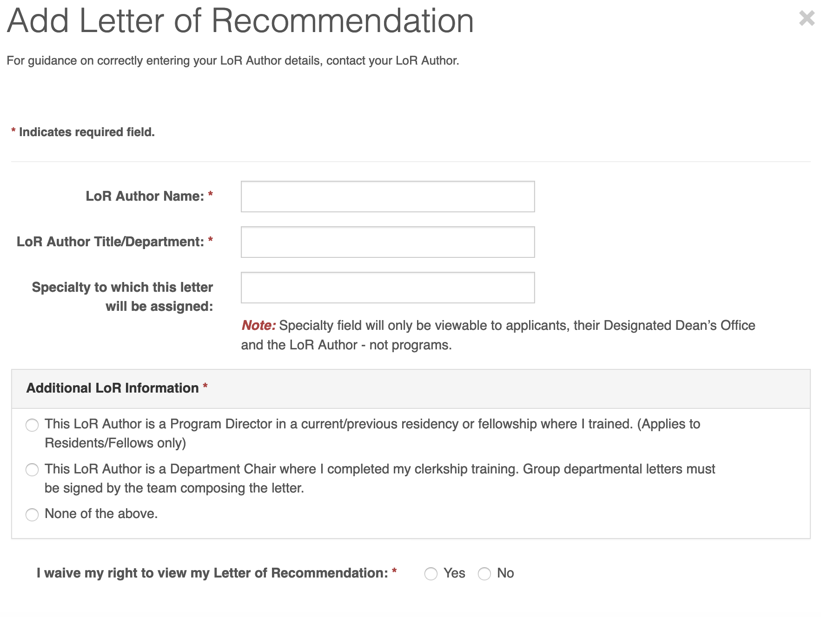
LOR in ERAS
1. How to write LOR Author Name?
Jane Doe, MD
2. Author Title/Department
If they have many titles, list the highest ranking and/or the one pertinent to your letter
(i.e. if they are M3 Clerkship Director and Associate Professor of Medicine, list Associate Professor, Department of Medicine as title)
*you can always go to the UMMC website and take the title from their department website if you are unsure
3. Additional LOR Information
First option: no one should choose this
Second option: choose if this person is writing your “chair letter”
Third option: choose this if this person is writing a regular LoR

Slide 20
LOR in ERAS
After you input information for the LOR, authorize it for upload
After authorizing it, download LOR identifier form for your letter writer.
  This is what you will hand them or email them. It has a unique link for that letter writer to use when submitting your specific letter.
  When they upload it using that ID#, it will automatically be stored in your ERAS application

Slide 21

Questions?

