Slide 1
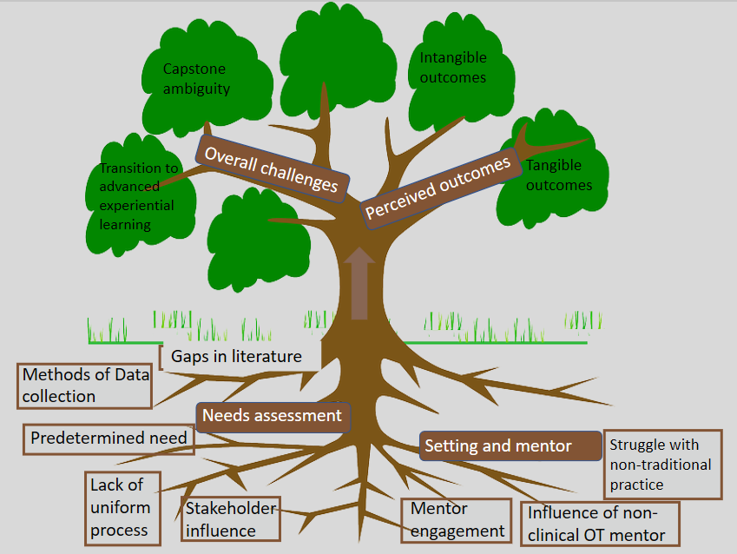
A Phenomenological Study to Explore the Doctoral Capstone Project
among Recent Graduates of Accredited Occupational Therapy Programs
Katie Cassady, OTS; Brittany Chisholm, OTS; Hannah Clark, OTS; Alex Grandonico, OTS; Brittany Hardin, OTS; Abbey Osha, OTS
Christy Morgan, PhD, MHSA, OTR/L; Kristy Cole, OTD, OTR/L
University of Mississippi Medical Center l Jackson, MS
ABSTRACT
RESULTS
METHODOLOGY
Purpose: The purpose of this phenomenological study was to discover how recent graduates of accredited entry-level OTD programs experienced and completed a doctoral capstone project.
Methods: This descriptive research study employed a qualitative design by using phone interviews with recent graduates from accredited entry-level
OTD programs to collect narrative data.
Results: Researchers gathered information about the needs assessment, setting and mentor impact, perceived outcomes, and overall challenges. According to participants, there was no uniform process for completing the needs assessment. Although a majority of the participants had a mentor with occupational therapy credentials, none were currently practicing in a traditional clinical role. All participants reported challenges and personal growth during their experience.
Conclusion: This study offers a step forward in understanding the capstone project of entry-level OTD programs from the student's perspective.
Capstone Setting and Project Overview
Research Design: This descriptive research study employed a qualitative design by using semi-structured phone interviews with recent graduates of accredited entry-level OTD programs to collect narrative data to understand student perceptions of the capstone project.
Participants: The researchers completed the semi-structured interview with seven graduates.
Data Collection and Analysis: The constant comparison method was utilized to analyze the transcripts. Researchers actively read the transcripts and made notes in the margins about what was read. The researchers then used open coding, going line by line highlighting specific phrases or concepts within the seven transcribed interviews. A code directory was established by each researcher and shared amongst members to create a list of agreed upon codes as a group. During focused coding, overlapping concepts were revealed. Triangulation was utilized to improve trustworthiness of the data analysis process (i.e., audit trail, coding reconciliation, external evaluator).
Capstone Student* | Capstone Setting | OT Mentor | Mentor Title | Capstone Project Type | Implemented
CS 1 | Sub-acute Inpatient Rehab | Yes | Director of Rehab | Program Development | Yes
CS 2 | Public Health Clinic | No | Program Manager | Policy and Program Development | No
CS 3 | Educational Health Clinic | No | Assistant Director of Clinic | Theory Based Program Improvement | No
CS 4 | Educational Setting | Yes | OT Program Director | Instruction Module on Theoretical Model | Yes
CS 5 | Three Assisted Living and Memory Care Facilities | Yes | CEO | Research Project | Partially
CS 6 | Hospital | Yes | Supervisor | Education Module | Yes
CS 7 | Patients’ Home and Work | Yes | Professor | Research-based Intervention | Yes
INTRODUCTION
CONCLUSION
The education for the entry-level occupational therapy degree has gone through multiple shifts, starting with only a diploma then transitioning to a bachelor’s, master’s, and most recently adding an entry-level doctorate degree option (AOTA, 2019). The Accreditation Council for Occupational Therapy Education (ACOTE) created additional competencies for OTD programs, including scholarship, program development, and advanced practice (ACOTE Standards, 2018). The advanced practice skills required by ACOTE place an increased emphasis on experiential learning, which can bridge the gap between academia and clinical practice by fostering new skills that are necessary for best practice (Knecht-Sabres, 2013). To meet this new experiential learning requirement, ACOTE’s 2018 standards mandate that a capstone be integrated into all OTD programs. According to the standards, the doctoral capstone should contain two parts: a capstone 14 week experience and a capstone project. The capstone project is driven by a specific need at the facility where the student is completing their capstone (Duquesne University, 2019). The project is guided by a needs assessment the student conducts with the capstone site., and it should be mutually beneficial.
This study offers a step forward in understanding the capstone project component of entry-level OTD program curriculum from the students’ perspective. Understanding the lived experiences of students concerning the overall process and resulting factors of the capstone project may benefit OT programs. Since the capstone requirement is a fairly new component of doctoral OT programs, there is limited research available on capstone projects specifically. Although the results of our study provide useful initial insights into the capstone project, we recommend further research to expand the knowledge and understanding of the capstone project for occupational therapy doctoral students.
*The participants in this study are referred to as a capstone student (CS) because they were reflecting on their capstone project which was completed while they were a student. Participants were graduates at the time this study was conducted.
“I grew because it gave me a chance to not only reconcile all that I learned in school, but it gave me a chance to be somewhat of a peer mentor in a way to the students who were going through the process.”
“I’m most proud of the impact it had on my perspective and the way I perceive my role as an occupational therapist.”
“My biggest challenge was actually kind of getting people to understand why I was there, I got a lot of push back from, from some of the staff member who had been there for 10 years.”
"I think what I'm most proud of is I helped develop some Level I fieldwork outcome measures."
LIMITATIONS
Limited sample due to the numerous steps required to access and recruit recent OTD graduates; yielded concerns over saturation
Transitioning accreditation standards with terminology and process implications
Difficulty for students to distinguish between the overall experience and capstone project
Inability to complete member checks to verify meanings from transcripts
PURPOSE
The purpose of this phenomenological study was to discover how recent graduates of accredited entry-level OTD programs experienced and completed a doctoral capstone project.
Areas of Inquiry
What steps did the student complete to conduct the needs assessment for the capstone project?
How did the student determine the purpose and scope of the capstone project?
How did the setting and mentor impact the development and completion of the capstone project?
What were the students’ perceived outcomes?
“I was so independent in the project almost too independent.”
OT IMPLICATIONS
OTD educators can use this study to more fully understand the capstone project from the student’s point of view.
Current and future OTD students can use this study to understand in advance that their capstone project will stretch them past their point of comfort as a doctorally prepared entry-level practitioner.
Capstone mentors can use this study to understand that their role and level of engagement has an impact on the OTD student’s challenges and growth throughout the capstone project.
IRB NUMBER: 2019-0233
Capstone Project: From Root to Leaf,
Growth of Occupational Therapy Doctoral Students
References available upon request

