Slide 1
The Basics of HIV: What? Who? How?
Mauda Monger, MPH
Director, Health Education (AETC)
Division of Infectious Diseases
University of Mississippi Medical Center

Slide 2
Objectives
Define HIV/AIDS
Epidemiology Overview
Who is at Risk
How is it transmitted
Facts and Fiction

Slide 3
Mississippi Stats
Mississippi had the 6th highest HIV diagnosis rate in 2015
78% of the new HIV cases documented in 2014 were African-American with diagnosis rates 7 times higher than Whites.
Jackson had the 4th highest HIV and 1st highest AIDS diagnosis rates in 2015 of any US metropolitan statistical area (MSA) with a population 500,000 or greater
Data based on 2013 MSDH Surveillance reports

Slide 5
What is HIV?
The Human Immunodeficiency Virus (HIV) is a virus that enters a person’s body and attacks their immune system. The virus kills cells in the immune system that protects us from infections. When this happens, the body is left weakened and defenseless against infections.
H - Human: a person’s body
I - Immunodeficiency: when the immune system lacks some elements and breaks down
V - Virus: a group of tiny cells that multiply in the body and cause diseases

Slide 6
What is AIDS?
Acquired Immunodeficiency Syndrome (AIDS) is a group of infections and diseases that occur because of the breakdown in the body’s immune system.
A- Acquired: something you are given or get
I - Immuno: the body’s defense system which normally protects us from disease
D - Deficiency: lacking or not enough
S - Syndrome: a group of diseases

Slide 7
FACT CHECK
HIV and AIDS there is a difference…
HIV does not equal AIDS:
HIV is a virus.
AIDS is a disease.
AIDS is a result of HIV infection.

Slide 8
WHO IS AT RISK?

Slide 9
Who is at Risk for HIV/AIDS?
EVERYONE is at risk…
Highest Risk –
Gay/Bisexual Men (African American and Hispanic Men)
African Americans (men and women)
Youth

Slide 10
Who is at Risk for HIV/AIDS?
Gay/Bisexual Men (African American and Hispanic Men)
  1 in 6 gay and bisexual men will be diagnosed with HIV in their lifetime
    1 in 2 Black/African American gay and bisexual men
    1 in 4 Hispanic/Latino gay and bisexual men,
    1 in 11 white gay and bisexual men
In Mississippi, more than 70% of those diagnosed with HIV in 2015 where AA men.

Slide 11
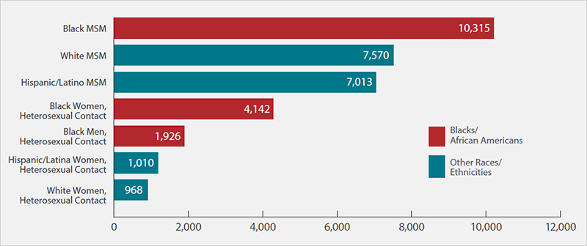
Who is at Risk for HIV/AIDS? - Race
HIV Diagnoses in the United States for the Most-Affected Subpopulations, 2015
Notes:
-HIV incidence among blacks was almost eight times higher than that of whites
Source: . HIV Surveillance Report 2016;27. Subpopulations representing 2% or less of HIV diagnoses are not reflected in this chart. Abbreviation: MSM, men who have sex with men.

Slide 12
Who is at Risk for HIV/AIDS? - Youth
Young people ages 13 to 24 accounted for more than 1 in 5 new HIV diagnoses in 2014. Most of those occurred among young gay and bisexual males
From 2010-2014, HIV diagnoses increased 19% among 15-24 year olds in Mississippi
Notes:
Source: . HIV Diagnoses in the United States for the Most-Affected Subpopulations, 2015-https://www.aids.gov/hiv-aids-basics/prevention/reduce-your-risk/who-is-at-risk-for-hiv/

Slide 13
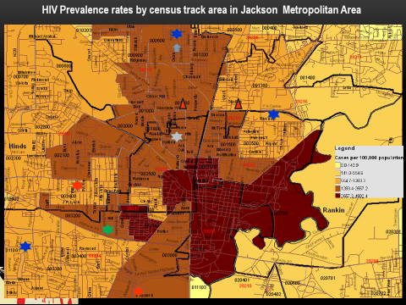

Slide 14
HOW IS HIV TRANSMITTED?

Slide 15
Modes of Transmission
HIV enters the bloodstream through:
  Open Cuts
  Breaks in the skin
  Mucous membranes
  Direct injection

Slide 16
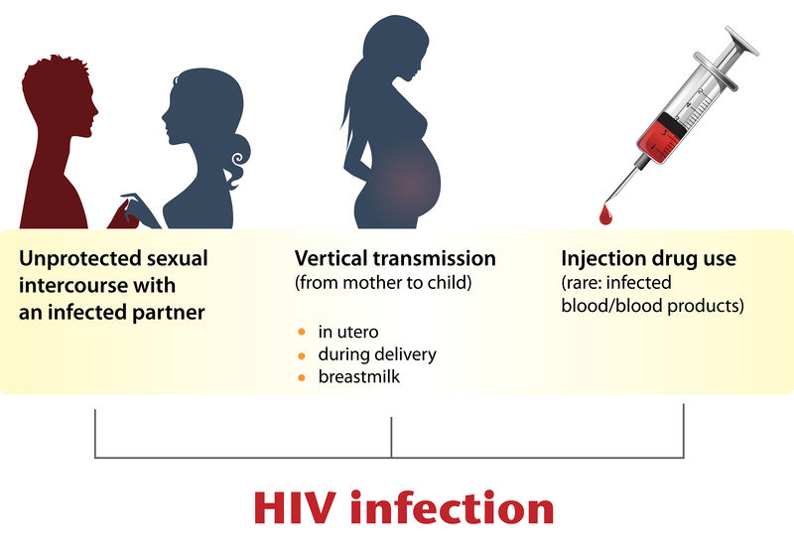
Modes of Transmission
Body fluids that spread HIV:
Vaginal Fluids
Semen
Blood
Breast Milk

Slide 17
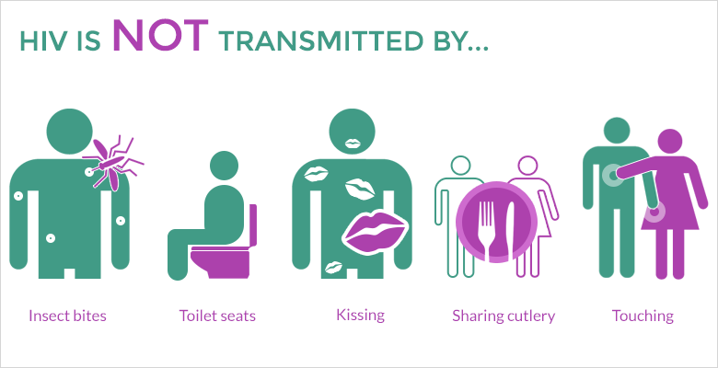
Modes HIV is NOT Transmitted

Slide 18
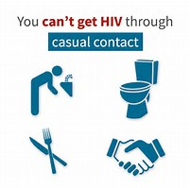
Ways HIV Cannot be Spread
Recreational or toilet facilities
Swimming in the same pool
Accepting served food
Sleeping in the same room

Slide 19
Getting Tested

Slide 20
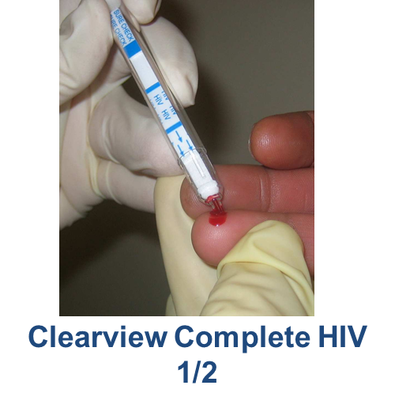
What should you know…
Testing is the only way to be sure
  An HIV test is the only way you can know your status
Cost
  You can get tested for free at multiple locations
Accurate
  Tests are 97-99% right when done correctly
How often
  You should be tested once a year
Testing is easy
  Rapid tests only take 1-20 mins to get results

Slide 21
FACT CHECK
You can not tell if someone has HIV or AIDS by the way they look
There is a HIV home test kit
Testing is easy, simple and doesn’t take a long time
Your results are only shared with you and your health care provider

Slide 22
Fighting Stigma

Slide 23
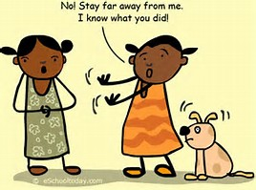
Stigma
Negative feelings, beliefs, and behaviors directed toward an individual or group due to a particular label or characteristic
HIV/AIDS Stigma: Negative feelings, beliefs, and behaviors directed toward individuals, groups and communities that are associated with HIV/AIDS
Notes:
A sense of devaluing a person’s worth as a result of a disease, such as HIV.

Slide 24
What do you think is the root cause of stigma?
Ignorance
Judgment
FEAR
Moral Bias
Discrimination
Prejudice
Misunderstanding

Slide 25
Root Causes of Stigma
Lack of awareness of what stigma looks like and why it is damaging
Fear of casual contact stemming from incomplete knowledge about HIV transmission
Values linking people with HIV to improper or immoral behavior (implicit bias)
Notes:
‘What does stigma look like? What does it sound like? Using words like “they”, “them”, “at risk” and “others”. It is damaging because it denotes a clear divide, that in some way PLWHA are in some way different, unimportant or segregated from everyone else.
Defining Implicit Bias. Also known as implicit social cognition, implicit bias refers to the attitudes or stereotypes that affect our understanding, actions, and decisions in an unconscious manner

Slide 26

Stigma and Students

Slide 27
Stigma Outcomes
Delayed/late testing
Don’t go the doctor
No support system
Constant Fear
Death
Notes:
Exercise think of some other medical problems that may lead to stigma: obesity, anoxia, and mental health issues.

Slide 28
Facts and Fiction
Only (all) people who are gay have HIV/AIDS
“Its my job as a health care professional or educator to inform family, coworkers and other students if a student is HIV positive.”
“The government and pharmaceutical companies have a cure for AIDS but are making too much money to release it.”
“A lot of information about AIDS is being held back from the public.”

Slide 29
Facts and Fiction
The HIV virus can get to an undectable level in the body.
If a person is clean, they can’t have HIV
HIV/AIDS is a not death sentence.
Straight or Gay, I am still at risk for HIV/AIDS.

Slide 30

Got a question…call me
Mauda Monger
601-984-5542
mmonger@umc.edu

