Slide 1
Creating Safe Spaces that Support an Inclusive Environment for Students and Staff
Rodney Washington, Facilitator

Slide 2
Session Overview
This session will enable participants to gain a greater understanding of issues and concerns surrounding youth who identify as LGBT. Learning outcomes will assist participants in the following:
Understanding terms and concepts of sexual and gender identity in a developmental context
Identify challenges and health disparities related to LGBT youth
Discuss strategies to create affirming and competent strategies for all students

Slide 3
What do we mean by Affirming and Inclusive?
Affirming
Inclusive
To offer emotional support and encouragement.
To declare positively
To declare support for or belief in
Welcoming
All Encompassing
Supports Participation
Unbiased Engagement

Slide 4
Key Terms for LGBTQ
Intersex — People who are born with reproductive or sexual anatomy that does not fit typical definitions of “male” or “female.”
Sexual Orientation — Romantic, emotional, and/or sexual attraction to others.
Gender Identity — An internal feeling of being male, female, or something else.
Gender Expression — Ways of showing gender to others, such as through mannerisms, clothes, and personal interests.
Questioning — Individuals who are unsure about their sexual orientation and/or gender identity.
(Engage Youth for Change http://engage.youth.gov/blog/lgbt-key-terms)

Slide 5
Cont..
Lesbian/Gay — Individuals who are romantically, emotionally, and/or sexually attracted to the same sex/gender.
Bisexual — Individuals who are romantically, emotionally, and/or sexually attracted to multiple sexes/genders.
Transgender — Individuals whose gender identity/expression is different from that typically associated with their assigned sex at birth.
Transitioning — When individuals begin to express their authentic gender, which differs from that typically associated with their assigned sex at birth. Individuals who are transitioning may express their gender identity through changes in clothes, hairstyle, and makeup/accessories and may undergo medical or surgical treatments.
( http://engage.youth.gov/blog/lgbt-key-terms)

Slide 6
TRANS, TRANSGENDER & TRANSSEXUAL
Trans*/Transgender – (adj) (1) An umbrella term covering a range of identities that transgress socially defined gender norms. Trans with an * is often used to indicate that you are referring to the larger group nature of the term. (2) A person who lives as a member of a gender other than that expected based on sex assigned at birth.
Transsexual – (noun & adj) a person who identifies psychologically as a gender/sex other than the one to which they were assigned at birth. Transsexuals often wish to transform their bodies hormonally and surgically to match their inner sense of gender/sex.
(PFLAG Atlanta, http://www.pflagatl.org/about-pflag-atlanta)

Slide 7
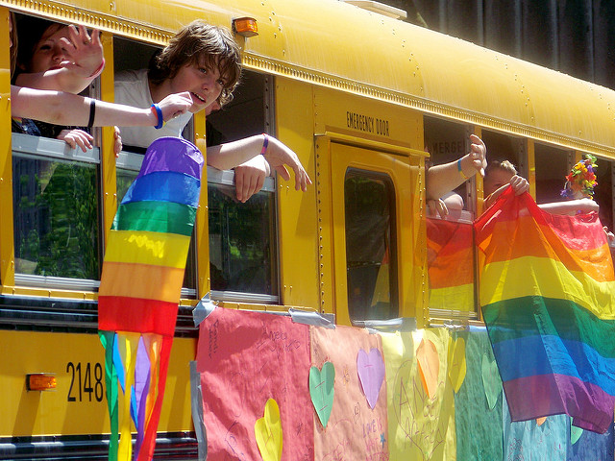
Why this is so Important
Kids at school keep telling me to kill myself’: Gay 13-year-old committed suicide after intense bullying
https://www.washingtonpost.com/news/morning-mix/wp/2016/12/06/kids-at-school-keep-telling-me-to-kill-myself-gay-13-year-old-committed-suicide-after-intense-bullying/?utm_term=.e7f9971e6e84
Larkin Street Stories: The Homeless LGBT Experience
https://www.youtube.com/watch?v=48mC89f6PgA

Slide 8
Risk Factors

Slide 9
Risk Factors

Slide 10
Challenges to Creating Safe Spaces
Reflect on your school environment and lets identify factors that you think would be challenging in creating a safe space for LGBT students.

Slide 11
Creating Safe Spaces for LGBT Students
Build strong connections and keep the lines of communication open. Some LGBT youth often feel rejected. It is important for them to know that their families, friends, schools, and communities support them.
Establish a safe environment at school. Schools can send a message that no one should be treated differently because they are, or are perceived to be, LGBT. Sexual orientation and gender identity protection can be added to school policies.
Create gay-straight alliances (GSAs). GSAs help create safer schools. Schools must allow these groups if they have other “non-curricular” clubs or groups.
Protect privacy. Be careful not to disclose or discuss issues around being LGBT with parents or anyone else.
(www.stopbullying.gov/at-risk/groups/lgbt/index.html)

Slide 12
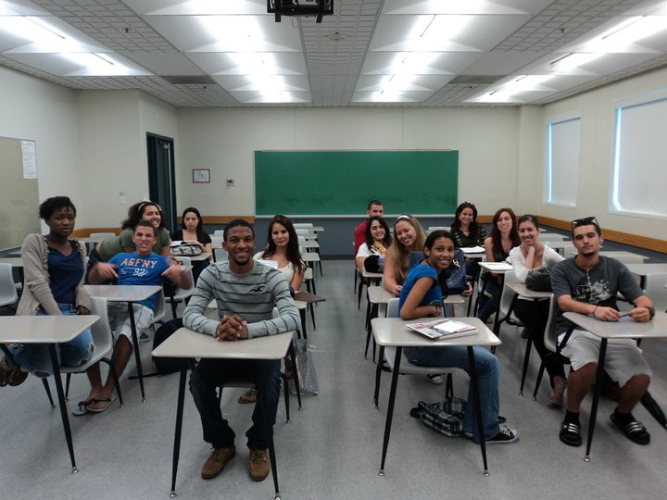
Recap and Discussion
Provide one “Take Away” to you could possibly Implement in your school to support an inclusive and affirming environment.

